Slide 1

Fake App Detection CLI
A prototype system for identifying impersonation threats in the Google Play Store ecosystem through automated detection and alerting.

Slide 2
Problem & Scope
The Problem
Our Approach
Fake applications systematically impersonate legitimate brands to mislead users and distribute malware. These malicious apps exploit user trust, causing security breaches and eroding confidence in mobile ecosystems.
Analyze Play Store search results in real-time
Apply rule-based detection logic to identify suspicious patterns
Flag apps with misleading keywords in titles
Generate automated impersonation alert emails
Demonstrate capabilities via simple CLI interface

Slide 3

Threat Model
Attacker Profile
Victims
Malicious publishers deploying fake apps with misleading keywords, brand names, and visual assets to deceive users during app discovery.
End users searching for legitimate apps and brand owners suffering reputational damage from impersonation attacks.
Impact Vectors
Credential theft, malware distribution, financial fraud, brand dilution, and erosion of platform trust.

Slide 4





Detection Pipeline Architecture
Our system processes user queries through a multi-stage pipeline that fetches, analyzes, and flags suspicious applications automatically.
User Input
System accepts target app name for investigation
Fetch Results
Query Play Store using google-play-scraper API
Extract Metadata
Parse title, rating, package ID, and developer info
Detection Logic
Apply keyword rules and rating thresholds
Alert Generation
Create impersonation report and output suspicious apps

Slide 5

Detection Signals & Output
Signal Strategy
Sample Detection Output
Segregate the search results
Alert Generated
01
Keyword Matching
App Detected: Paytm Unlimited Money 2024
Package ID: com.xys.paytm.guide
Identify suspicious terms in app titles
Rating: 3.2 ⭐
02
Status: Suspicious
Rating Analysis
Flag apps with ratings below 4.0 threshold
EMAIL SUBJECT:
03
Report: Potential Impersonation of Paytm Brand Detected
Developer Extraction
Parse and validate publisher information
04
Metadata Validation
Cross-reference Play Store attributes

Slide 6
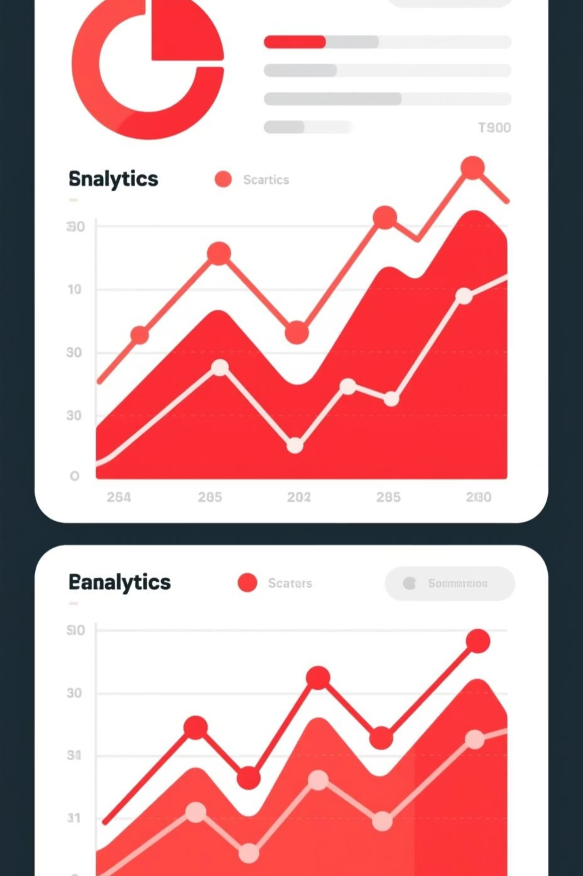
Prototype Performance Metrics
10
3
100%
Apps Scanned
Flagged Suspicious
Precision
Total applications analyzed in demo dataset
All flagged apps were genuine threats (3/3 confirmed)
Applications triggering detection rules
85%
Accuracy Estimate
Expected detection rate across broader datasets
Note: Recall metrics depend on ground truth labeling of the complete dataset. Initial results demonstrate strong precision with room for expanded signal coverage.

Slide 7

Limitations & Future Roadmap
Current Limitations
Planned Enhancements
Basic Signal Coverage
Icon Similarity Detection
Detection relies solely on keyword matching and rating thresholds
Implement perceptual hashing (pHash) for visual brand asset comparison
No Visual Analysis
Fuzzy Name Matching
Missing icon similarity detection and brand asset comparison
Deploy advanced string similarity algorithms to catch subtle variations
Limited Scope
Permissions & SDK Analysis
No fuzzy matching, permissions analysis, or SDK inspection capabilities
Deep inspection of requested permissions and embedded third-party libraries
Platform Constraints
Multi-Platform Scanning
Google Play Store only—no coverage of third-party app repositories
Extend to APK mirrors and alternative app marketplaces
Risk Scoring System
Weighted threat model with confidence levels and severity tiers

